Slide 1

RNA Seq Analysis App
Developer: Jason Lubega
31.03.2025

Slide 2

Intro
What are we doing?
Quick visualizer of RNA Seq Data.
The norm is that RNA Seq analysis experimental data is static and the only insights we can get from it is what is reported in the corresponding publications. UNLESS…
More insight beyond what was published means reanalysing the data again. What if, we could come back to this data anytime we wanted and ask new questions easily.
Exhaust all possible conclusions in one place, and fast.
Helps explore insights to scientists and goes beyond static images.
Scientists (end users) can interact and prompt the data.
Could use input from: GEO or inhouse data or Nextflow output.
We can also benchmark good data structure (esp. experiment metadata) practices by bench scientists by creating templates.

Slide 3
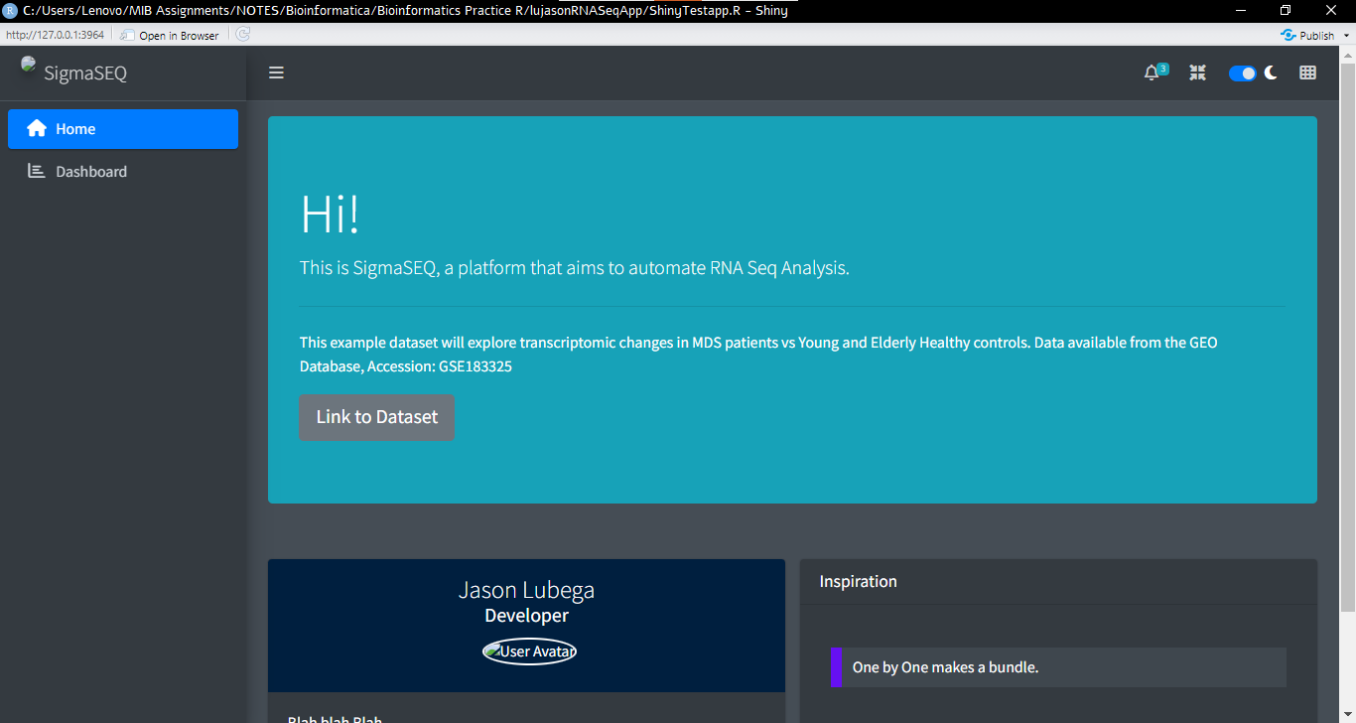
Notes:
Using this Dataset as Demo Dataset

Slide 4
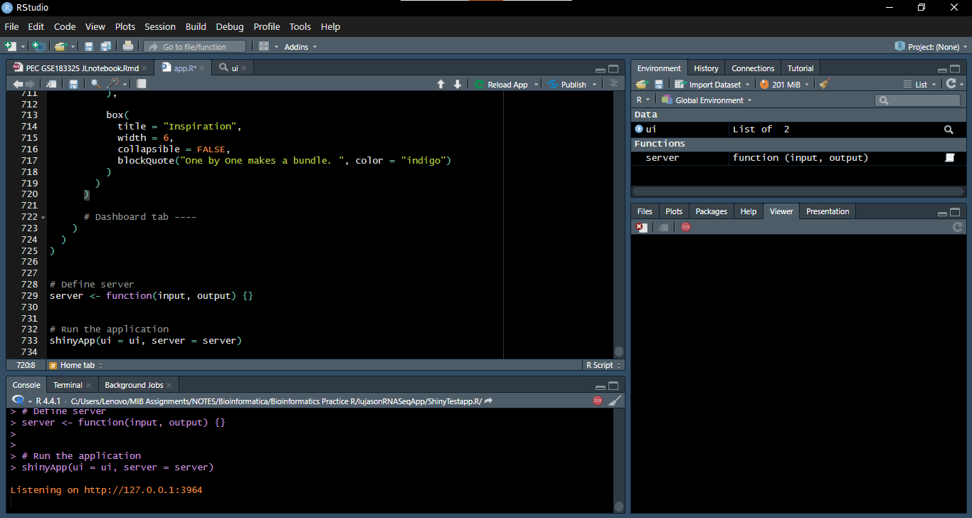

Slide 5
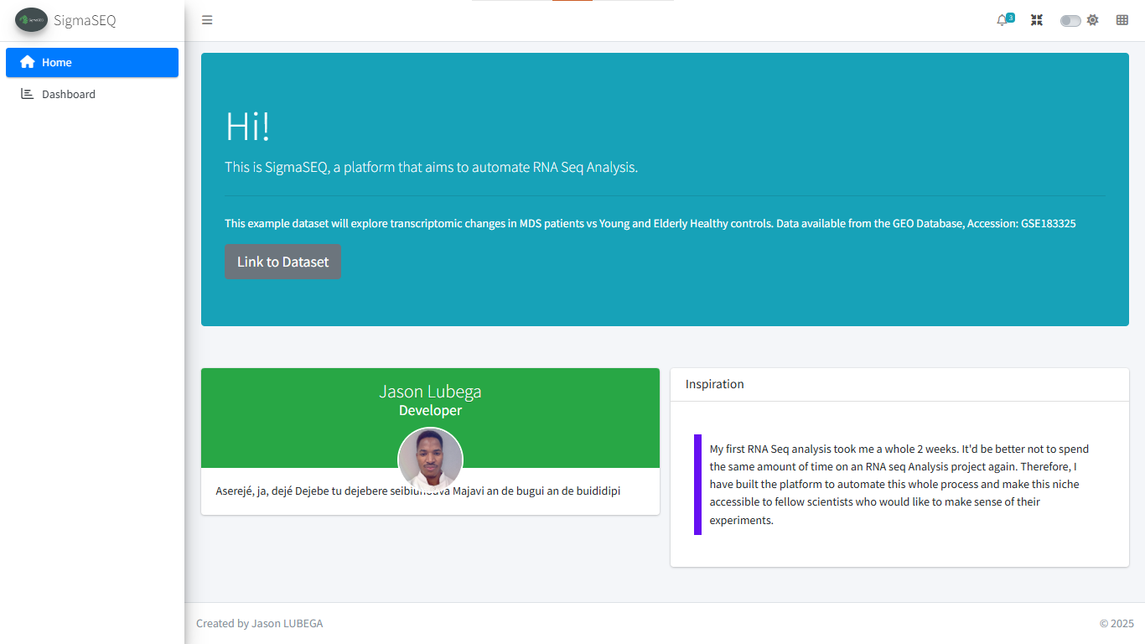
Notes:
Using this Dataset as Demo Dataset

Slide 6
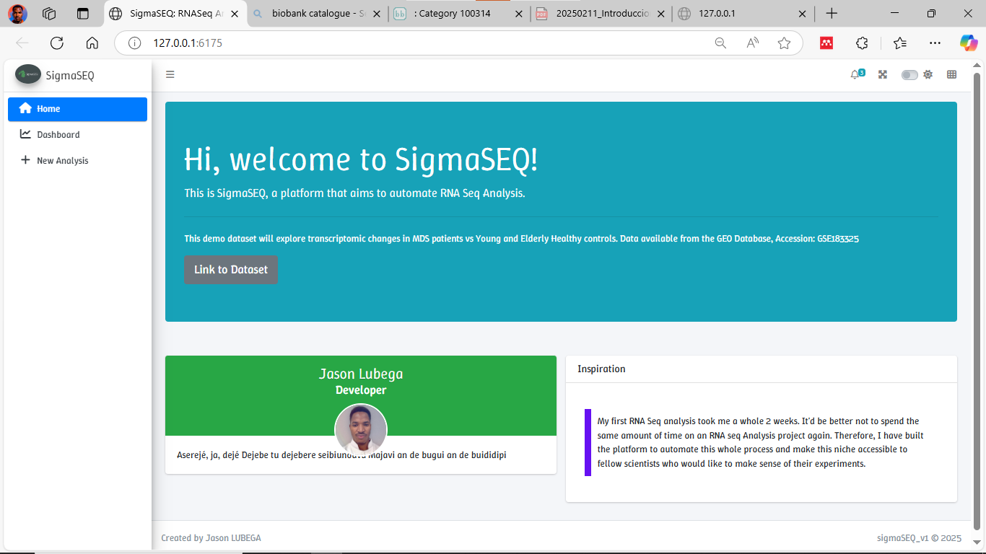

Slide 7

Dashboard | PROPOSAL

Slide 8





Total Counts
#00 genes
Significant genes
#00 genes
Differentially Expressed
#-- genes
Enriched Pathways
#-- genes
+ New Analysis
Bar Chart x
Volcano Plot x
Tables ?
Average Counts ?
Significant genes
Files
Counts Matrix
Sample Metadata
Significantly Expressed genes
Enriched Pathways
Downloadable
PCA Plot x
Heatmap x

Slide 9
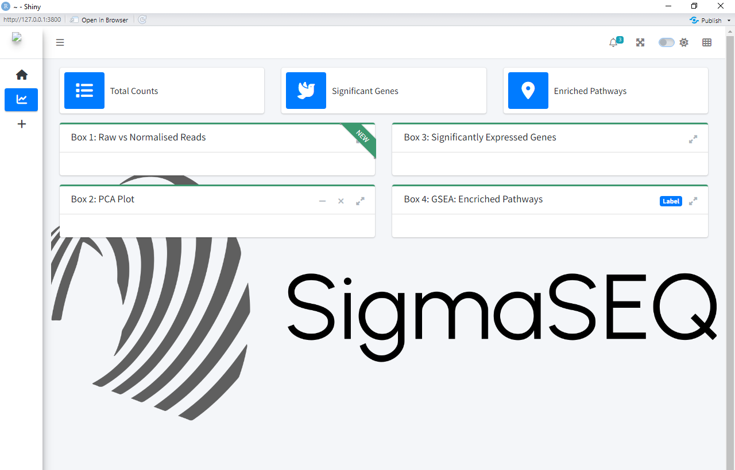
RESULT: 03 April, 2025

Slide 10
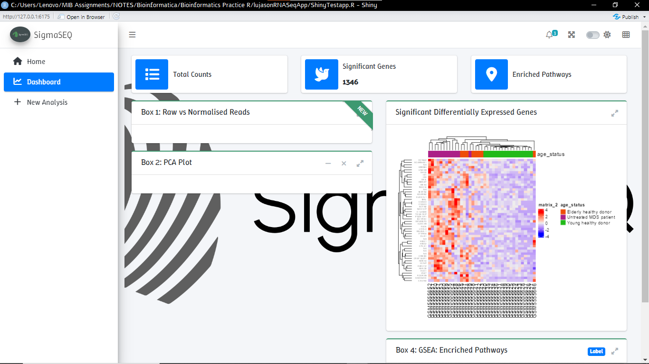

Slide 11
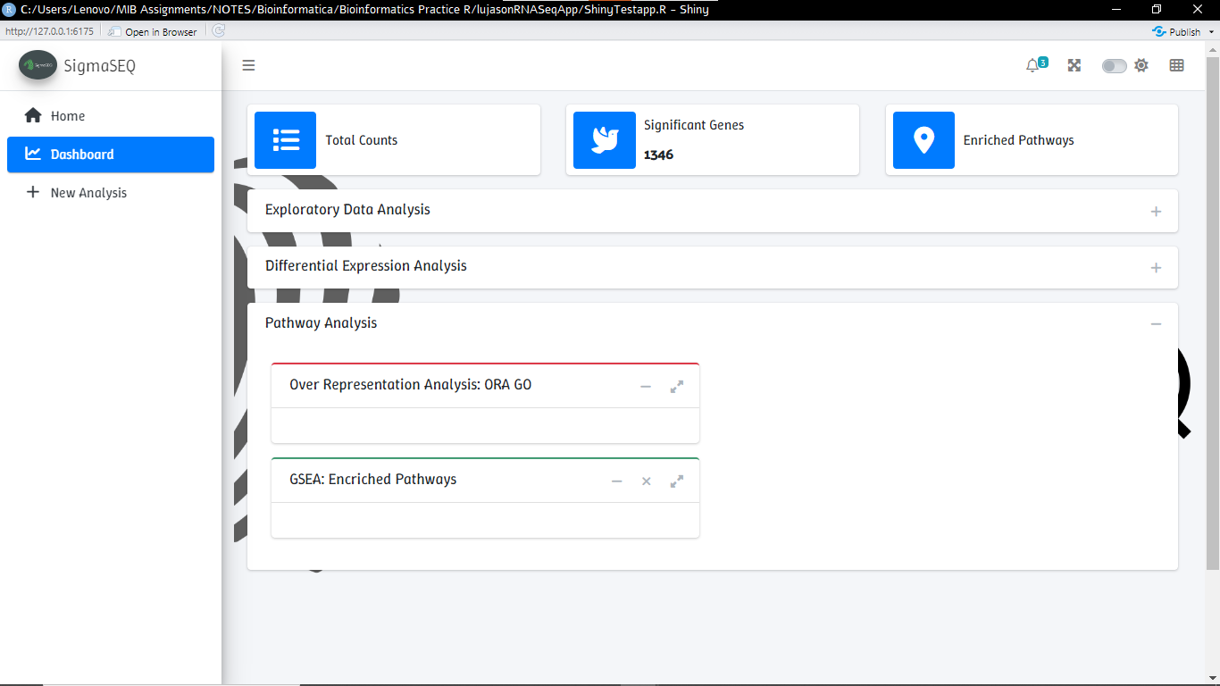

Slide 12
New Analysis Tab | PROPOSAL

Slide 13
+ New Analysis Tab
Starting from:
GEO Dataset with GSE accession (Geoquery)
Starting from Count Matrix, FASTQ or BAM file???
If 1: Identifying the right files from the Dataset, sometime the count matrix is in the Suppl files and not in the expression set.
If 2: Add more preprocessing pipeline like Rsubread.
Automatic identification of species.
Fetch metadata and add intergrate it to your file list.
Make things work: Test different GSE numbers and input formats.

Slide 14
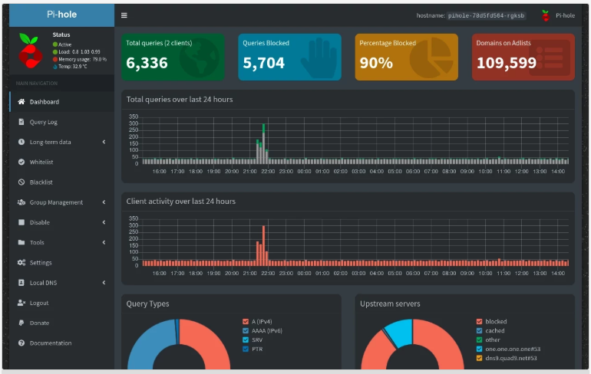
Examples (Pick infoboxes’ colors and layout format)

Slide 15
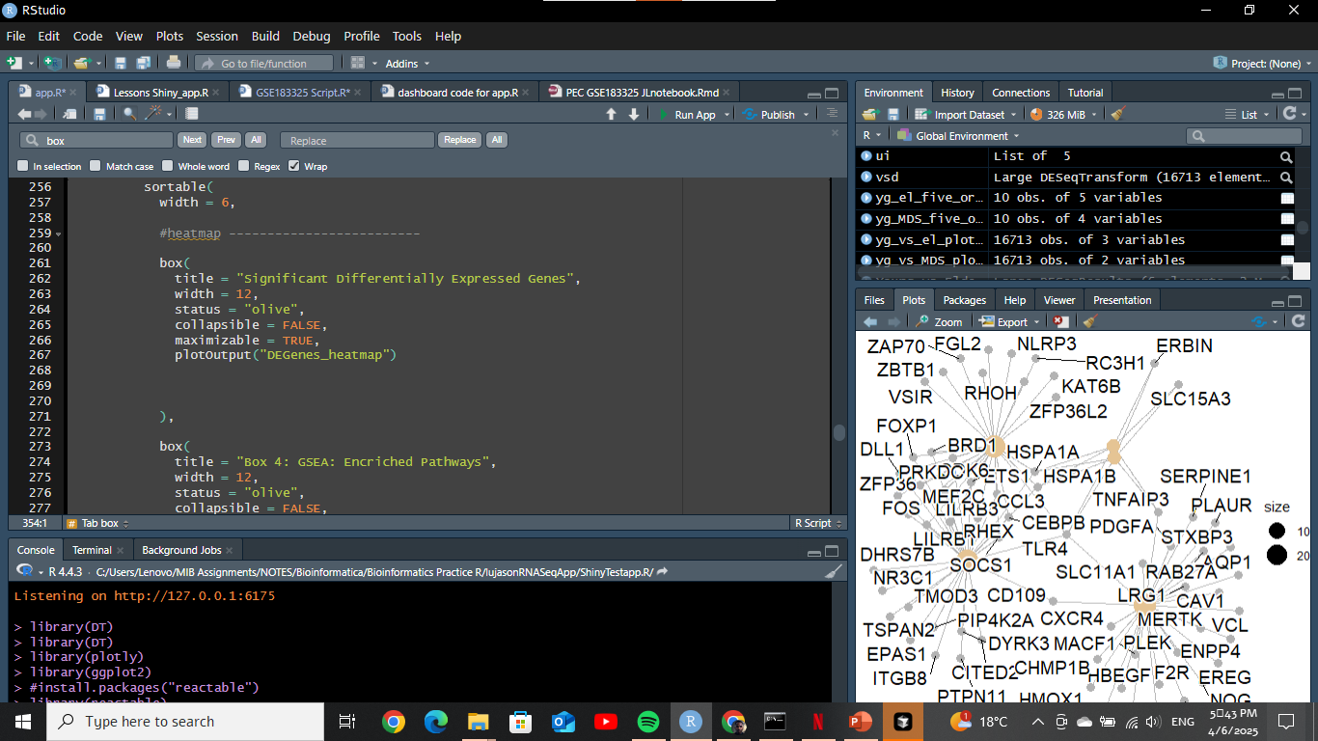

Slide 16
Pivots
Use the Data Analysis description to recreate analaysis.
Use GIT hub code to catch clues of how data was analysed.
Then automatically check boxes for analysis prompts that apply.
Further GPT Data prompting to enable generation of new figures. (refer to jchengs r chatbot.)

Slide 17
UPDATE
This project took a drastic turn and saw commendable progress when I started using Cursor AI.
I have two apps now; one is more marketable.
sigmaSEQ v2

Slide 18
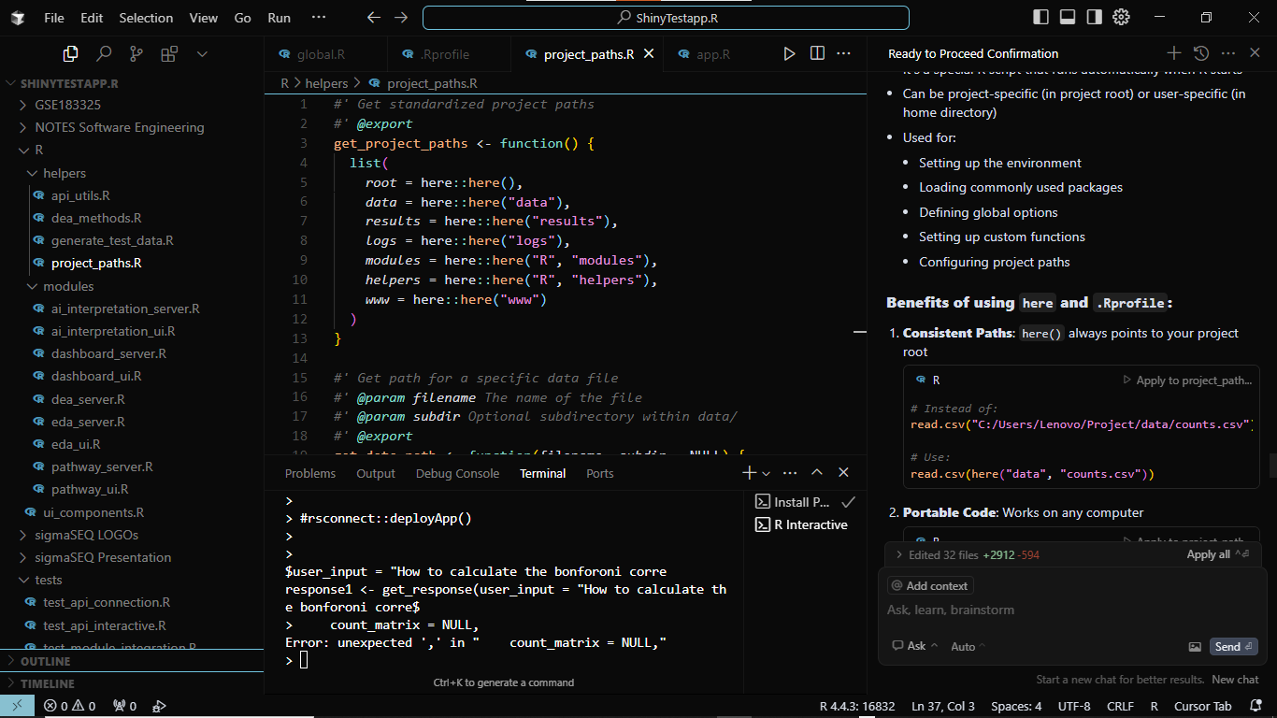

Slide 19
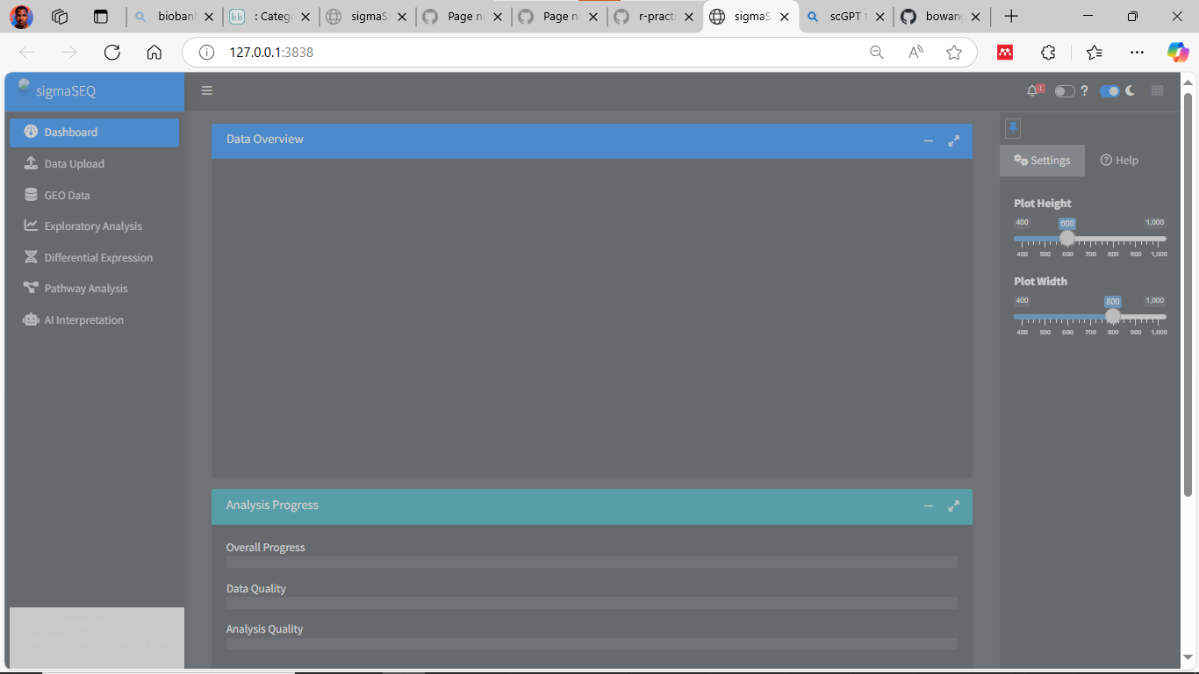

Slide 20
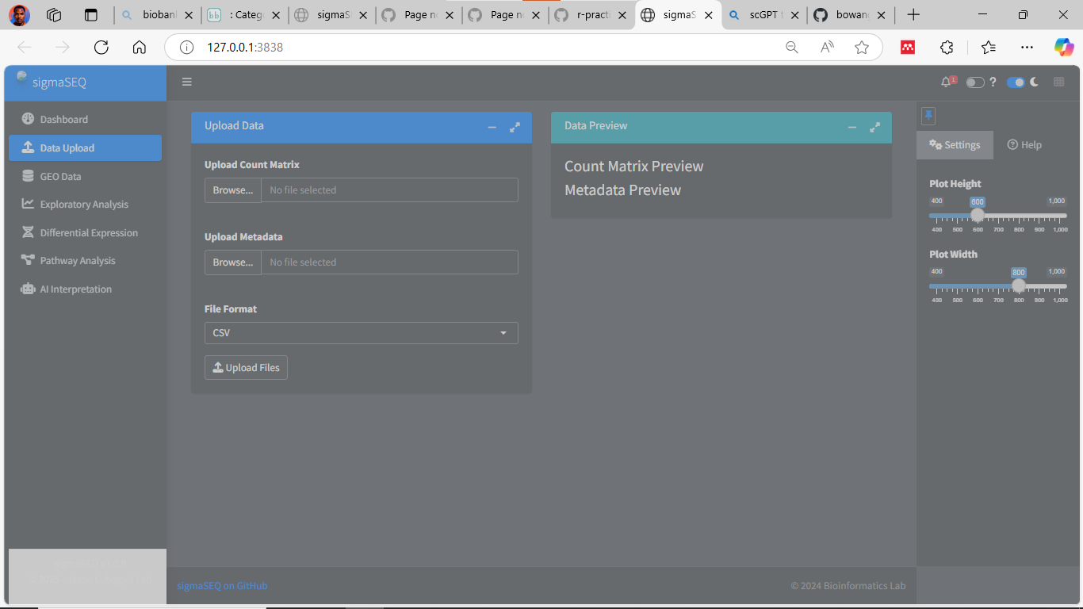

Slide 21
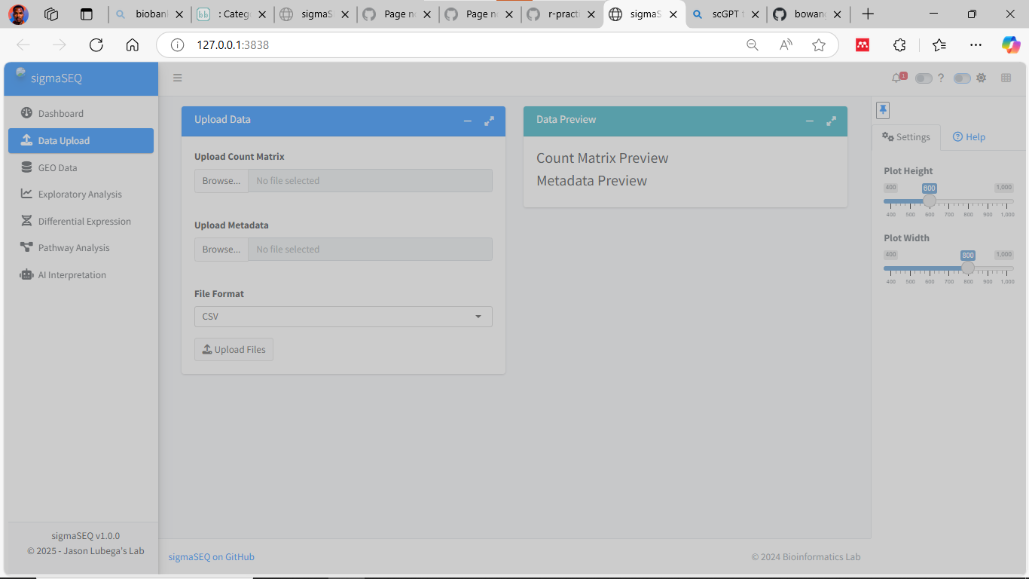

Slide 22
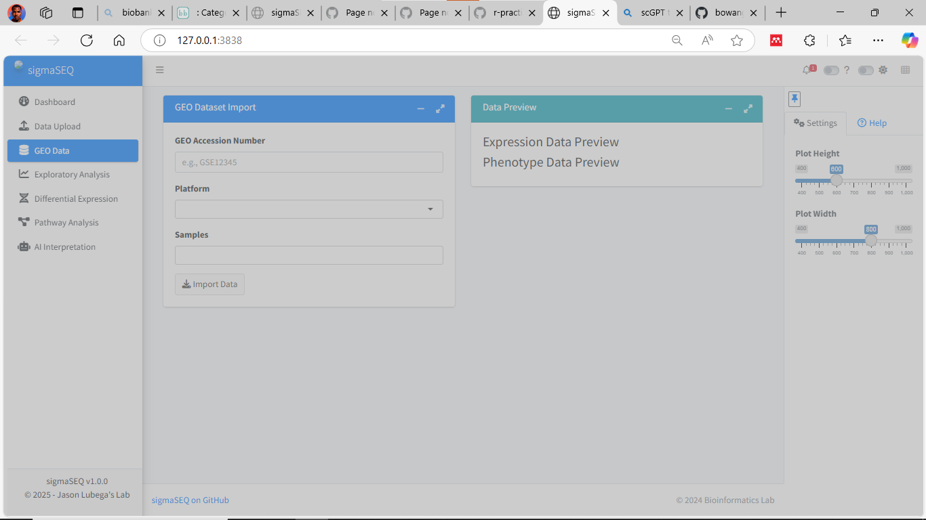

Slide 23
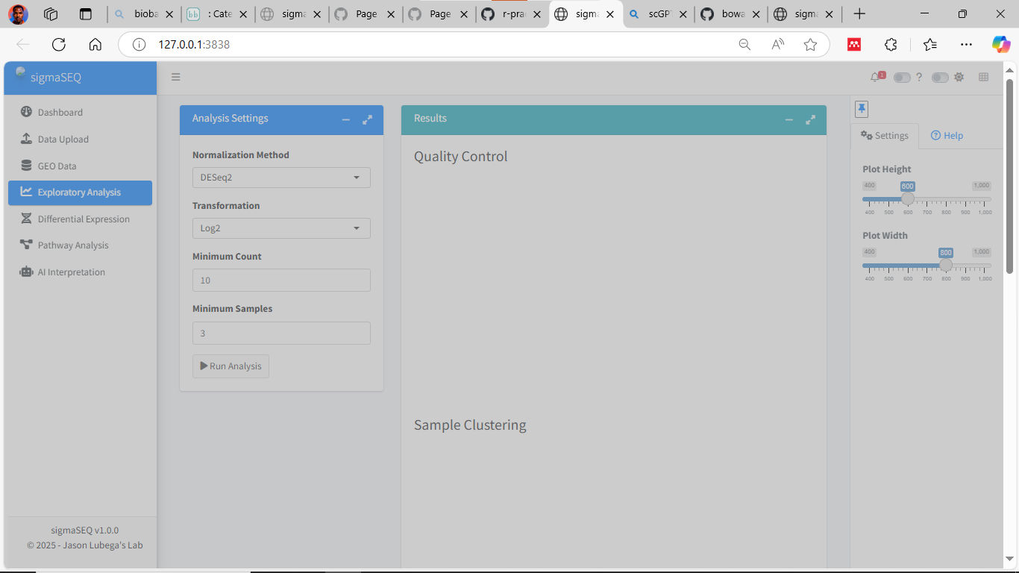

Slide 24
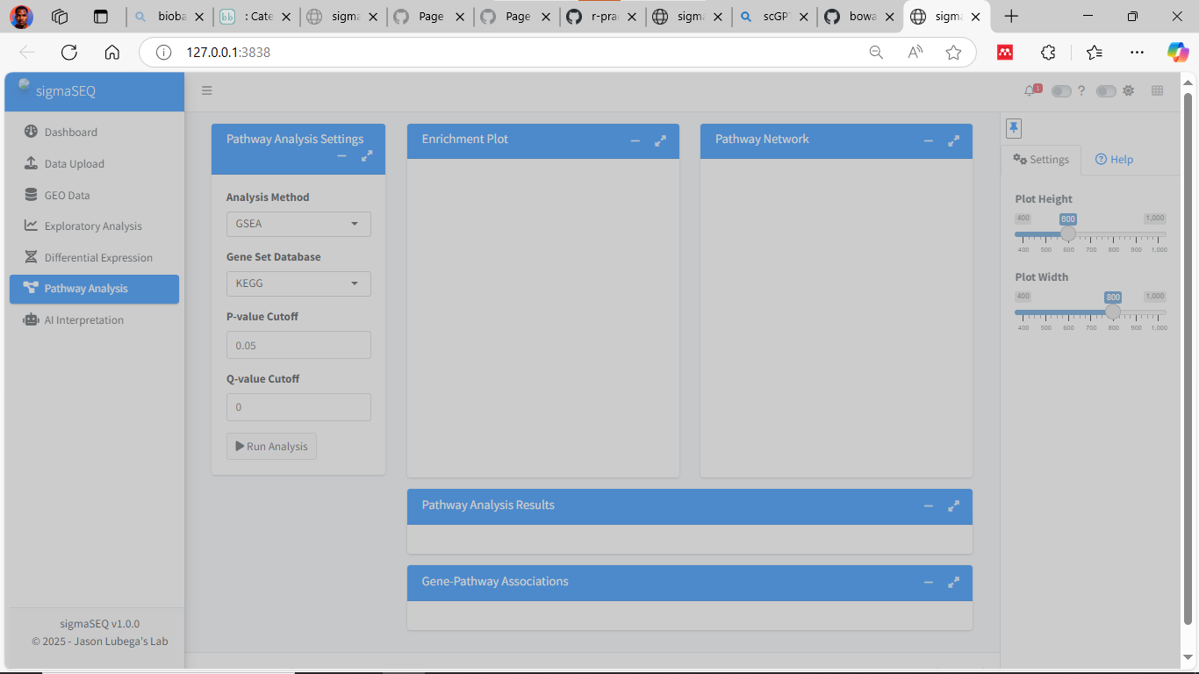

Slide 25
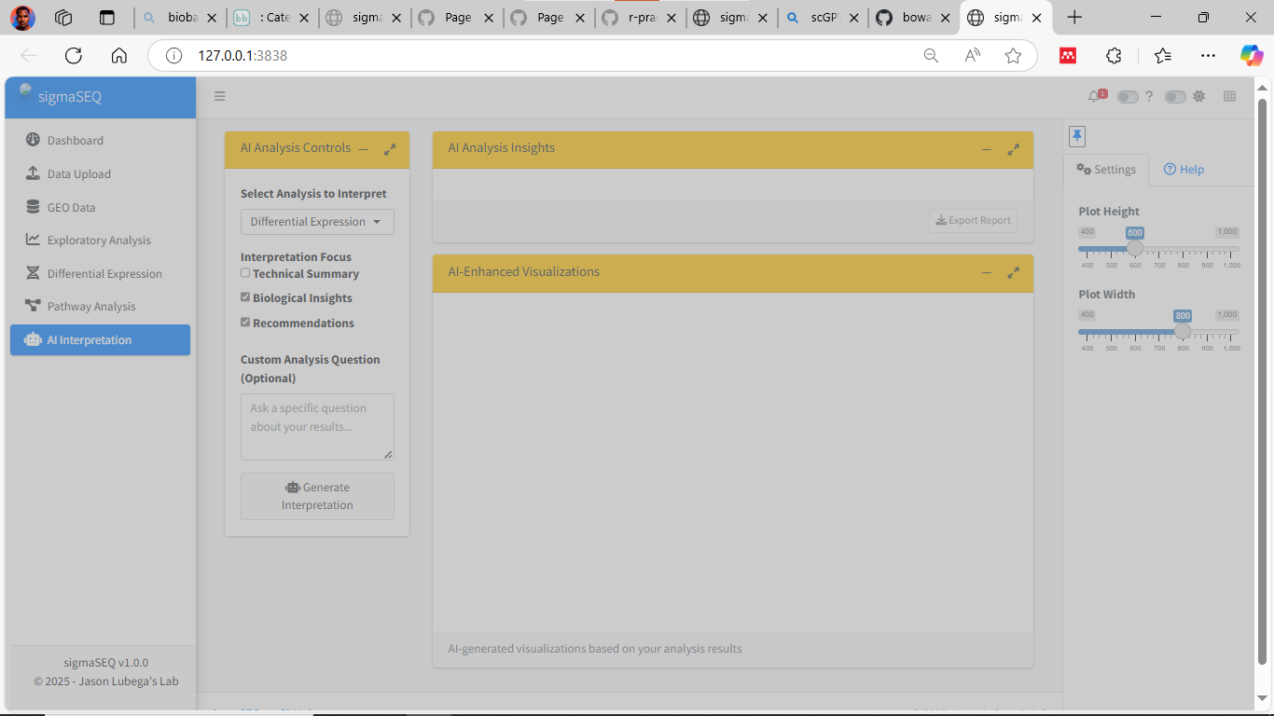

Slide 26
TO DO LIST 15.April.2025
Test app with counts data.
Test fetch functions and features.
Try 3 GEO accession IDs.
Test AI interpretation tool.
Data wrangling to predefined format feature.
Custom plots.
Footer change. DONE
Theme change.
Add feature to download plots created. DONE

Slide 27
TO DO LIST 21.April.2025
Test app with counts data.
Test fetch functions and features.
Try 3 GEO accession IDs. (main objective)
Test AI interpretation tool.
Data wrangling to predefined format feature.
Custom plots.
Footer change. DONE
Add feature to download plots created. DONE

Slide 28
JOURNAL

Slide 29
